Slide 1
Annual Food Fair
A Celebration of Eating

Slide 2
The Menu
Chocolates Desserts
Cakes and Puddings
Roast Meals
Using Pasta Creativity

Slide 3
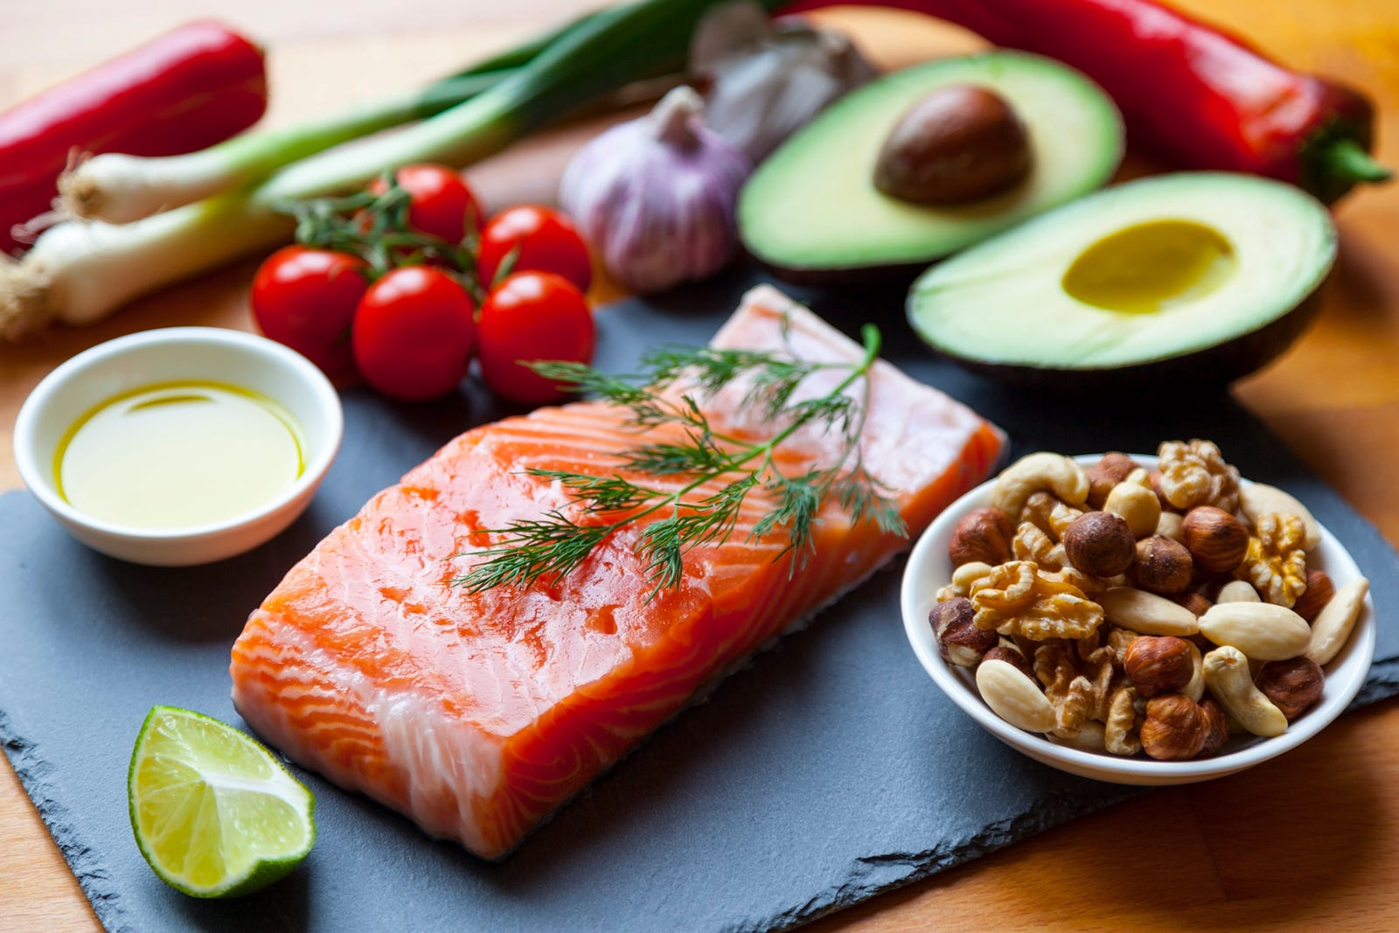
Meet The Team
Maggie Peet, Manager
Brian Webb, Bookings
Janine Newton,Publicity
Gregg Brown, Accounts
This Photo by Unknown Author is licensed under CC BY

